Slide 2
Record and Playback USRP-2954 - streaming with full bandwidth (200MS/s)
Kornél Nagy [kornel.nagy@ni.com]
2019 Q1

Slide 3
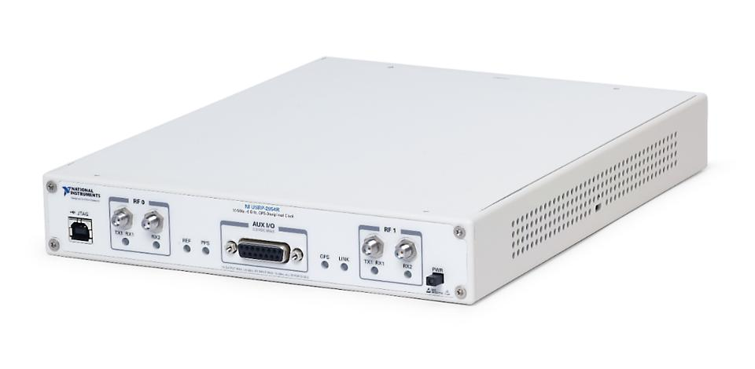
Requirements Overview
USRP-2954 Specification:
Frequency range: 10 MHz – 6 GHz
Channels: 2 Rx and 2 Tx
Instantaneous bandwidth: 160 MHz/ch
Maximum IQ sample rate: 200 MS/s
DAC resolution: 16 bit
ADC resolution: 14 bit
Throughput per channel: 200 MS/s X 2 Bytes X 2 (IQ samples) = 800 MB/s
Throughput for two channels = 800 MB/s X 2 = 1600 MB/s
SFP+ port throughput: 10 Gbps = 1250 MB/s
Regarding the hardware capability and requirements, streaming two Tx channels with maximum IQ rate,
each channel could be streamed through an individual SFP port, using Aurora streaming.
Notes:
x4 PCIe (Gen1) = 1GBPS
x8 PCIe (Gen2) = 4GBPS
PXIe-1085 (Gen 3) OR PXIe-1095 → 8GBps / slot
PXIe-8238 10GbE → 1.25GB/s
PXIe-8384 MXI extension

Slide 4
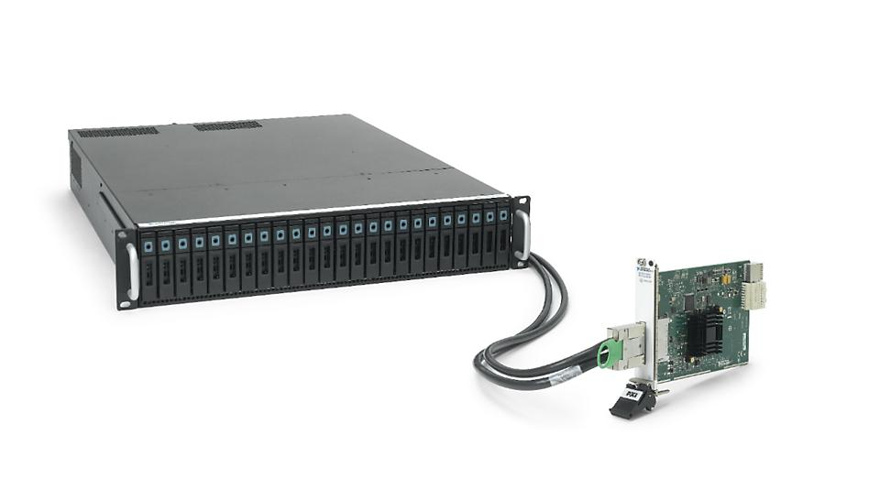
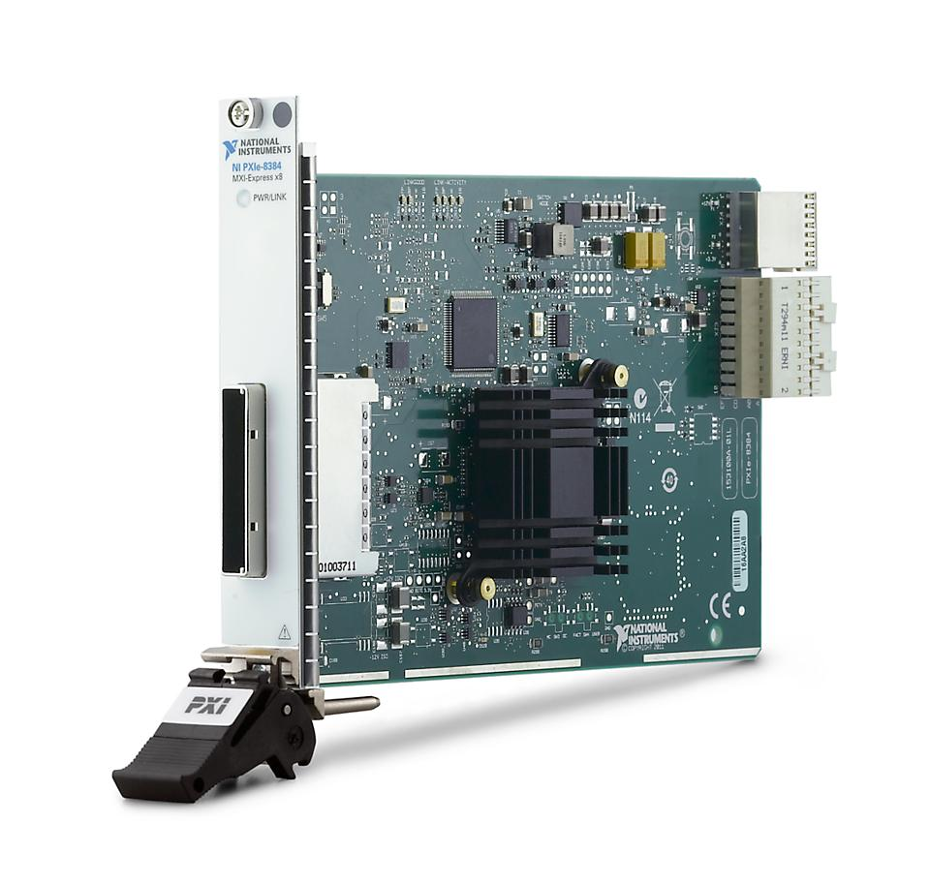
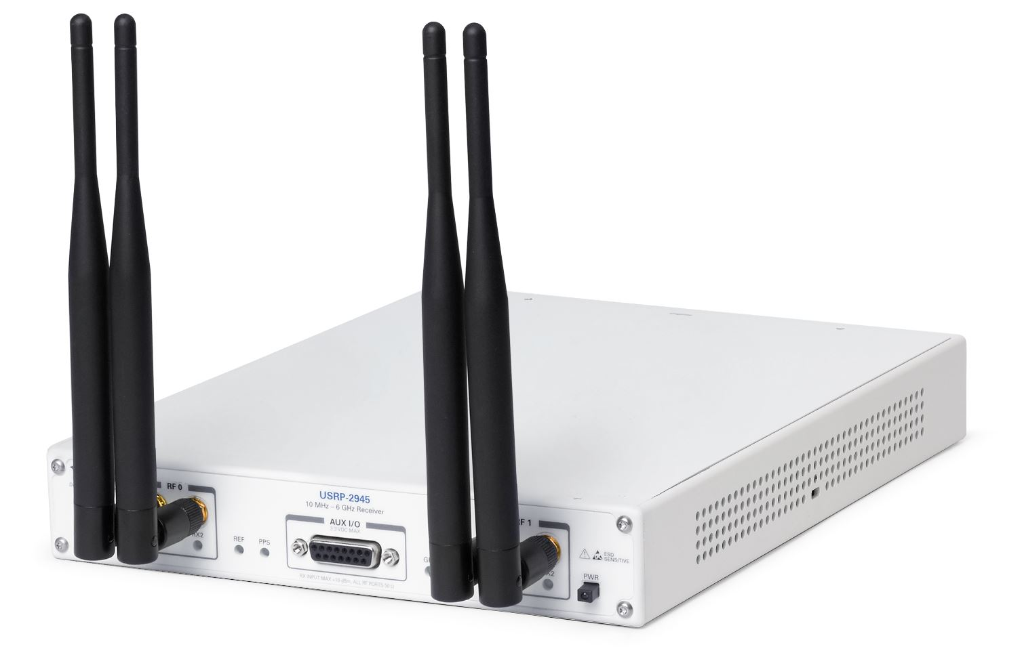
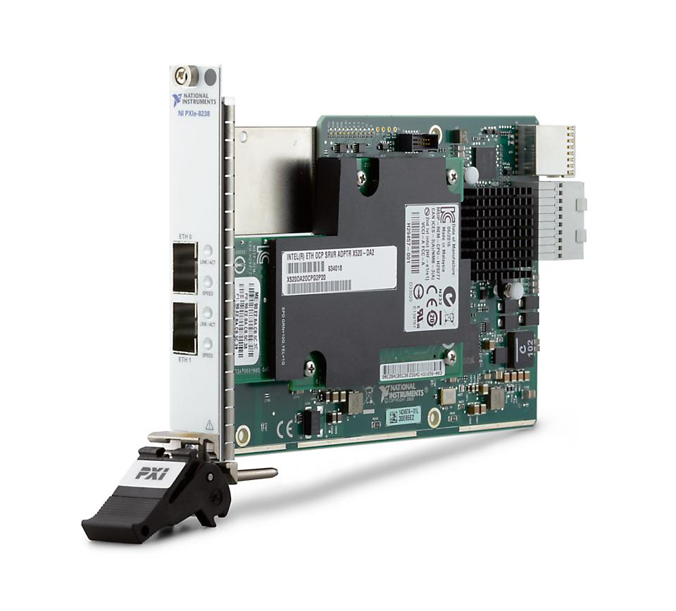
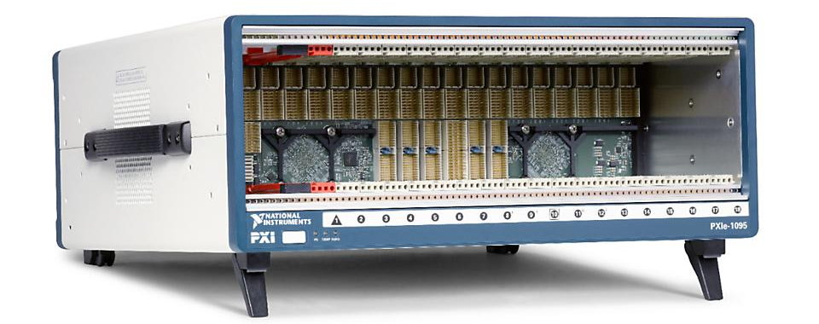
Suggested hardware setup
Software:
LabVIEW 2018 64-bit
LabVIEW FPGA
NI USRP 18.1
NI LabVIEW Instrument Design Libraries for High Speed Serial Instruments 18.0
Hardware:
PXIe-6592R
USRP-2954 (160MHz)
PXIe chassis, controller and MXI card. The project was tested using the following setup
PXIe-1095
PXIe-8135
PXIe-8374
RAID Array. The project was tested using the following setup
PXIe-8384
HDD-8266
Notes:
x4 PCIe (Gen1) = 1GBPS
x8 PCIe (Gen2) = 4GBPS
PXIe-1085 (Gen 3) OR PXIe-1095 → 8GBps / slot
PXIe-8238 10GbE → 1.25GBps
PXIe-8384 MXI extension

Slide 5
Rx dataflow for 1 channel
200 MHz Clock
156,25 MHz Clock
I
DSP
USRP
Rx 0 fifo write
Rx 0 fifo read
Pack data
Rx 0 SFP 0 fifo write
Rx 0 SFP 0 fifo read
AXI4-S write Endpoint
Q
SPF port
High-Speed Serial
AXI4-S read Endpoint
Port 0 Rx Output FIFO read
PXIe backplane
Host
Port 0 Rx Output FIFO read
TDMS Write
16-bit data (I OR Q)
32-bit data 1 X (I+Q)
64-bit data 2 X (I+Q)

Slide 6
Tx dataflow for 1 channel
156,25 MHz Clock
200 MHz Clock
DSP
Q
USRP
AXI4-S read Endpoint
Tx 0 SFP 0 fifo read
Tx 0 SFP 0 fifo write
Unpack data
Tx 0 fifo read
Tx 0 fifo write
I
SPF port
High-Speed Serial
Port 0 Tx Input FIFO read
AXI4-S write Endpoint
PXIe backplane
Host
TDMS Write
Port 0 Tx Input FIFO read
16-bit data (I OR Q)
Handshaking for backpassure on stream using Rx direction on SFP
32-bit data 1 X (I+Q)
64-bit data 2 X (I+Q)

